Slide 2
Choosing the path of pain:
A Plugin System in Rust

Slide 3

About myself
🧍 Mario Ortiz Manero
📚 Last year CS @ University of Zaragoza, Spain
❤️ Open source enthusiast
🦀 Wanted more real-world experience
🌎 https://nullderef.com
📍 Dolomites, The Alps

Slide 4


Joining the mentorship
I wanted to get better at software development & Rust
Summer was coming -> perfect moment to do it
Found Tremor in
Ended up joining them via
Overlapped with university work, so I decided to make it my final year project as well

Slide 5

What’s Tremor?
“An early-stage event processing system for unstructured data with rich support for structural pattern-matching, filtering and transformation.”

Slide 6
What’s Tremor?
In very simplified terms:
Onramp
Event (data)
Processing
Event (data)
Offramp
TCP packets
Standard Input
Metronome (time)
etc
Filtering
Transforming
Multiplexing
etc
TCP server listening
Standard Output
PostgreSQL
etc
Tremor tries to make this very performant

Slide 7
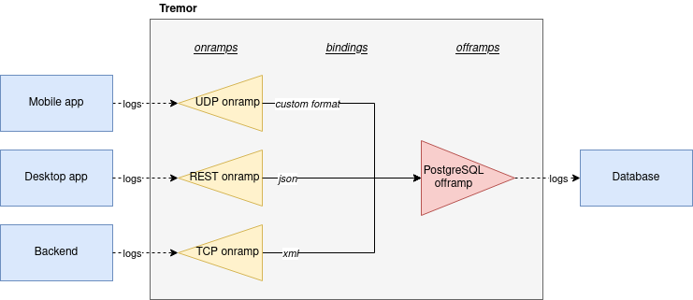

What’s Tremor?
Typical example:
Collecting and transforming logs from different applications (onramps) into a single database (offramp)
But also possible:
A Discord bot with commands (onramp) to control Spotify (offramp)*
*unimplemented yet
And more!

Slide 8
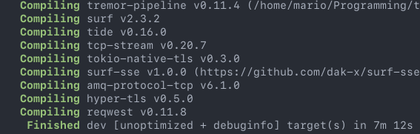



Why a Plugin System?
Compilation times
Modularity
Discord onramp
Spotify offramp
YAML codec
base64 postprocessor
Learning from other similar projects

Slide 9



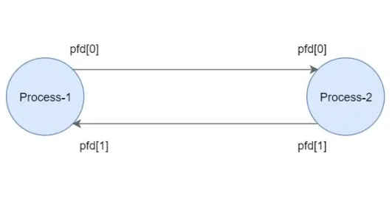
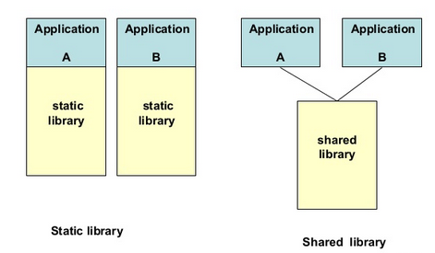

Why “choosing the path of pain”?
Many ways to implement a plugin system:
Scripting languages
WebAssembly
Inter-Process Communication
Dynamic loading
The only one performant enough for Tremor’s use-case is “dynamic loading”

Slide 10
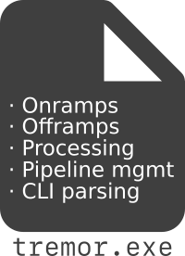
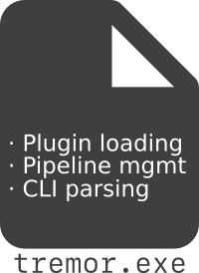

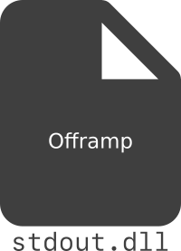
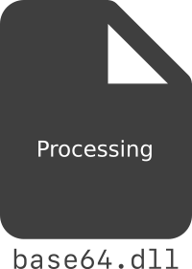
Why “choosing the path of pain”?
Dynamic loading works at the binary level: we split up the single executable into a runtime and dynamic libraries with the functionality
The runtime can load these libraries into its memory, and call the functions that they export

Slide 11

Why “choosing the path of pain”?
…but dynamic loading isn’t even possible with plain Rust
This is because Rust doesn’t have a stable Application Binary Interface (ABI). Which is actually good most of the times*
The whole part of “calling functions from the plugin” and the exported types’ layouts is undefined by Rust
*This is a somewhat controversial debate that I won’t discuss in detail in this brief presentation

Slide 12

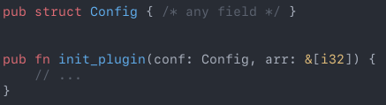
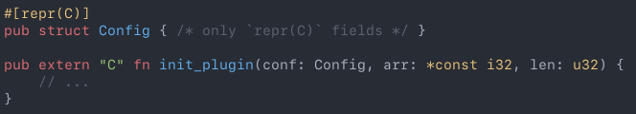
Why “choosing the path of pain”?
Solution: using the C ABI instead. We can resort to how it handles function calls and type layouts
Basically, writing C with Rust for the interface
A plugin in an ideal world
A plugin in the real, dream-shattering world
Good news is that Rust’s abstractions have made it an easier and safer job so far

Slide 13




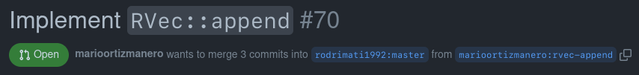
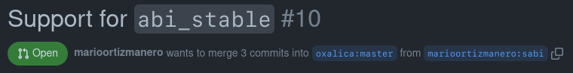
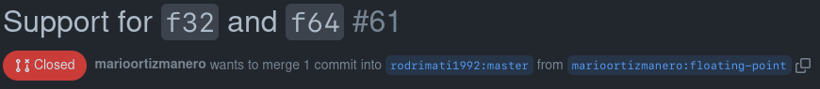

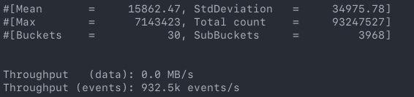
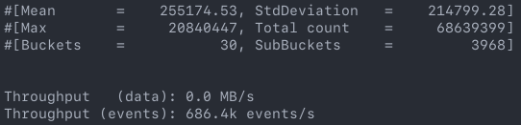
The results
It works!
Still not in production, though
Contributed to many other upstream projects
Managed to make Tremor…
~35% slower :D
Before PDK
After PDK

Slide 14


What’s next?
You can continue contributing to the project, it's open source!
Personally not done yet:
Benchmarks, tests, getting ready for deployment, polishing
(it works)

Slide 15
My progress
Start
Learn as much as possible
Fail catastrophically, look for new idea
Implement smaller, self-contained experiments
Start developing on the codebase
???
Eventually you arrive to something good enough

Slide 16
What I learned
📝 Note-taking
https://nullderef.com/series/rust-plugins/
🗄️ Organizing myself
Kanban, issues, PRs
📖 Researching on my own
About dynamic loading, ABI stability, etc
🦀 Rust in depth
Lots of prototypes & the final implementation

Slide 17
Tips
#1 You're going to get things wrong
100%. Prepare for failure and learn from it
#2 Make some rough plans of what you’ll do
But don’t get overwhelmed if they aren’t going as you expected
#3 Take good notes of your progress
Avoids forgetting things, helps explain others, and re-organizes your thoughts
#4 Take advantage of your mentors
They're there for you, and want you to succeed

Slide 18



Thanks to…
The Rust open source community for the help
All the Tremorites out there for bearing with me
The Linux Foundation for making this possible

